Slide 2
Find the time complexity of the below code
void Function( int n) {
int i, count = 0;
for(i=1; i*i<=n; i++)
count++;
}

Slide 3
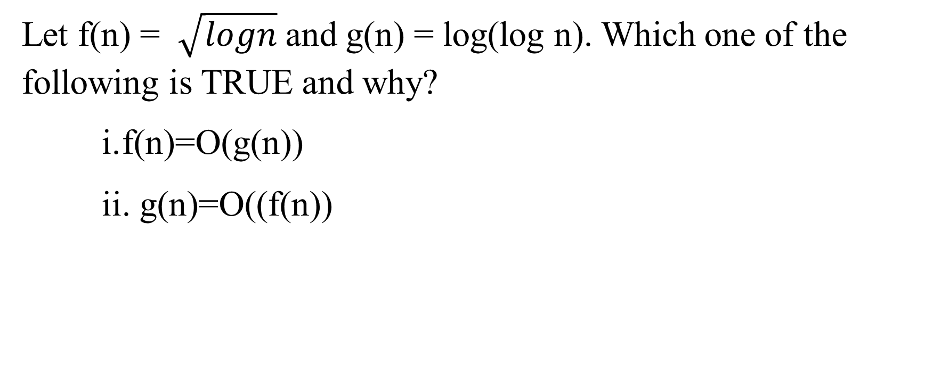
Let f(n) = $\sqrt{logn}$ and g(n) = log(log n). Which one of the following is TRUE and why?
f(n)=O(g(n))
g(n)=O((f(n))

Slide 4

T(n)= 4*T(n/2) + $\frac{n∗n}{\log{n}}$ What is the time complexity of the algorithm which follows the recurrence relation?

Slide 5

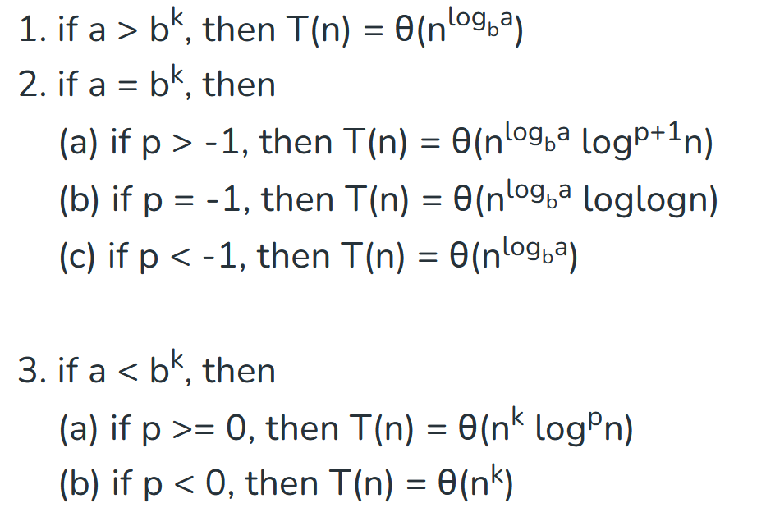
a>=1 , b> 1, k>=0, p is real number

Slide 6
What is the number of swaps required to sort n elements using selection sort in the worst case?

Slide 7
Suppose we need to sort an array of eight integers using the quicksort algorithm, and we just finished the partitioning with the array: {2, 5, 1, 7, 9, 12, 11, 10}?. Which elements can be the pivot element?

Slide 8
​Let T(n) be the recurrence relation defined as follows:
T(0) =1, T(1)= 2 , T(n) = 5*T(n-1) - 6*T(n-2) for n >=2
Find the time complexity of the algorithm which follows the above recurrence relation using back substitution method?

Slide 9
What does the following function print for a given Linked List with first node as head
void fun(struct node* head)
{
if (head == NULL)
return;
fun(head->next) ;
printf ("%d", head->data ) ; }

Slide 10
Find the Output of the following function to head pointing to the first node of the following linked list?
1->2->3->4->5->6
void fun(struct node* head)
{ if(head == NULL)
return;
printf("%d ", head->data);
if(head->next != NULL )
fun(head->next->next);
printf("%d ", head->data); }

Slide 11
Consider the following array { 89, 19, 50, 17, 12, 15, 2, 5, 7, 11, 6, 9, 100 }. The minimum number of swap operations needed to convert it into a max-heap is

Slide 12
Assume that the mergesort algorithm, in the worst case, takes 30 seconds for an input of size 64. Which of the following most closely approximates the maximum input size that solves it in 6 minutes?

Slide 13
For the given elements, perform the counting sort and explain the steps in detail 2, 9, 7,4, 1, 8, 4

Slide 14
Derive the time complexity of Quick sort using back substitution for average case time complexity ?

Slide 15
Write a function to swap the first node and the last node in the circular single linked list?

Slide 16
void swapFirstAndLast(struct Node** head) {
if (*head == NULL || (*head)->next == *head) { return; }
struct Node* temp = *head,* lastNode = NULL,* secondToLastNode = NULL;
// Traverse the list to find the last and second-to-last nodes
while (temp->next != *head) {
secondToLastNode = temp;
temp = temp->next; }
lastNode = temp;
// Swap the first and last nodes by updating next pointers
lastNode->next = (*head)->next;
(*head)->next = secondToLastNode->next;
secondToLastNode->next = *head;
*head = lastNode;
}

Slide 17
A function f defined on stacks of integers satisfies the following properties. f(ϕ)=0 and f (push(S)) = max (f(S), 0) + i for all stack S and integers. If a stack S contains the integers 2, -3, 2, -1, 2 in order from bottom to top. What is f(S)?

